Slide 1
THEORIES OF ENTREPRENEURSHIP
Theory of Status Withdrawal
By Everett Hagen
प्रतिष्ठा नष्ट होण्याचा सिद्धांत
DR. A. A. KULKARNI
DEPARTMENT OF COMMERCE
GOPAL KRISHANG GOKHALE COLLEGE, KOLHAPUR

Slide 2
Status withdrawal
“in the perception on the part of the members of some social group that their purposes and values in life are not respected by groups in the society whom they respect and whose esteem they value”

Slide 3
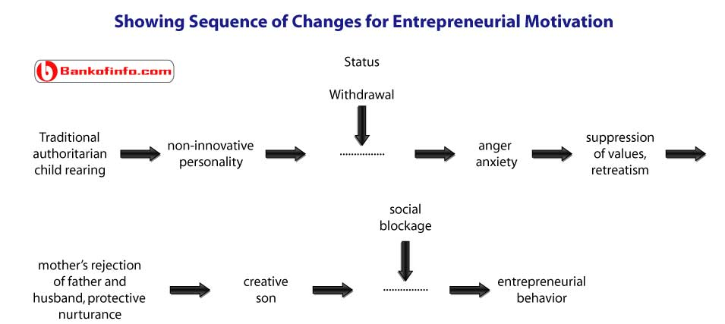

Slide 4
उद्योजक नसलेल्या व्यक्तीचे रूपांतर उद्योजकांमध्ये होण्याकरिता त्या व्यक्तीची प्रतिष्ठा नष्ट होण्याची क्रिया कारणीभूत ठरते
trigger mechanism

Slide 5
कारणे :
भौतिक बळाचा वापर
प्रतिमा मालिन करणे
प्रतिष्ठेच्या प्रतिकांमध्ये विसंगती
नवीन समाजात अपेक्षित प्रतिष्ठा न मिळणे

Slide 6
Hagen postulates the fur types of events can produce status withdrawal:
Displacement by force, e.g., the Norman invasion of England or the derogation of merchants, samurai, and wealthy peasants in seventeenth-century Tokugawa Japan;
Denigration of valued symbols, e.g., suppression of religious sets in seventeenth-century Russia and England;
Inconsistency of status symbols with a changing distribution of economic power
Nonacceptunce of expected status on migration to a new society e. g, the Amioquents in seventeenth-century Colombia.

Slide 7
FOUR POSSIBLE REACTIONS
(a)Retreatist: Entrepreneur who continues to work in society but remains indifferent to his work or status. माघार घेणारे
(b)Ritualist: One who works as per the norms in the society hut with no hope of improvement in the working conditions or his status. परंपरावादी
(c)Reformist: One who is a rebellion and tries to bring in new ways of working and new society. सुधारणावादी
(d)Innovator: An entrepreneur who is creative and try to achieve his goals set by himself. नवनिर्मीतीवादि

Slide 8
He developed this thesis from the case of the samurai community of Japan
Traditionally, this community had enjoyed a high status of which it was deprived later.
To regain this lost prestige, it became more active and vigorous and gave rise to many entrepreneurs.

Slide 9
INDIAN EXAMPLES:
Jains could be successful entrepreneurs because of their consciousness of their majority and superiority complexes.
Marwadi Community: Displaced from their own land
Sindhi community: displaced
Parsi community: displaced and spread all over the old
Brahmin community

